Slide 1

Olympic challenge
SQL CASE STUDY

Slide 2
MY ROLE
I am a DATA ANALYST working on a Olympic challenge project. My Tasks involves
Compiled and cleaned data from the 'athlete_events' and 'noc_regions' datasets to prepare it for analysis.
Executed SQL queries to extract, join, and manipulate data for insights and reporting.
Conducted data analysis to identify trends, medal counts, and statistics related to participating countries, athletes, and sports events across various Olympic games.
Developed complex queries to filter and aggregate data, enabling efficient data processing.

Slide 3
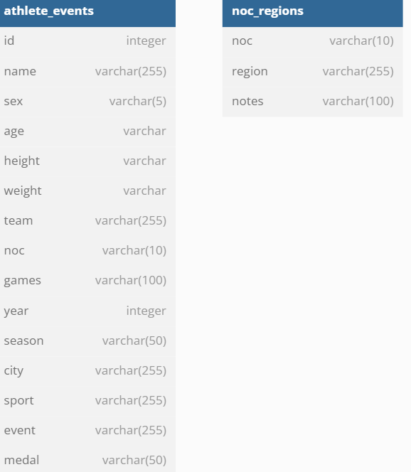
Tables:

Slide 4

Q1: How many olympics games have been held?
select count(distinct games) as Total_games
from athlete_events;

Slide 5
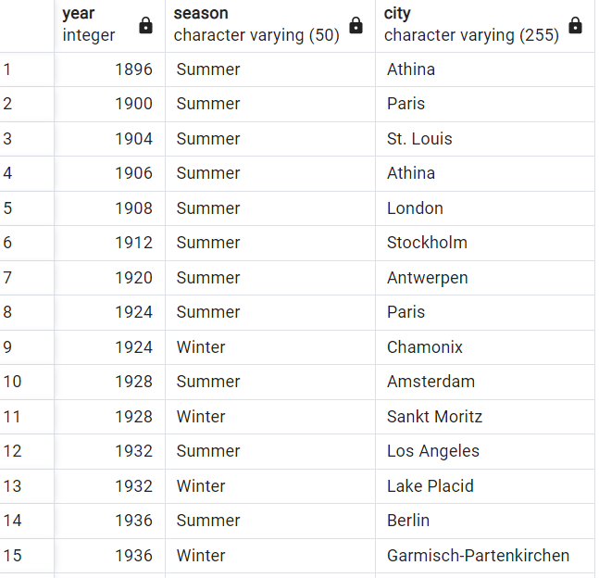
Q2: Write a SQL query to list down all the Olympic Games held so far?
select year,season,city from athlete_events
group by year,season,city
order by year,season;

Slide 6
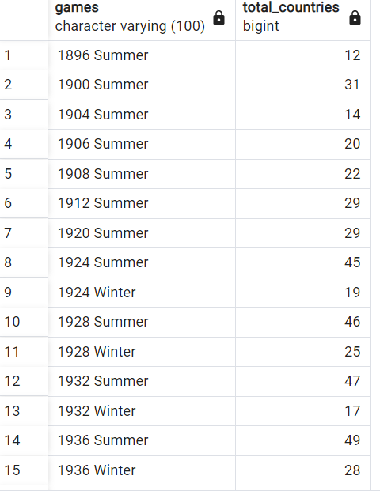
Q3: Write SQL query to fetch total no of countries participated in each olympic games.
select e.games,count(distinct (n.region)) as Total_countries
from athlete_events e
join noc_regions n on
n.noc=e.noc
group by e.games
order by e.games;

Slide 7

Q4: Write a SQL query to return the Olympic Games which had the highest participating countries and the lowest participating countries.
with countrycounts as(
select e.games,count(distinct n.region) as country_counts
from athlete_events e
join noc_regions n on n.noc=e.noc
group by e.games
)
select concat(max_country.games,'-',max_country.country_counts)as highest_countries,
concat(min_country.games,'-',min_country.country_counts) as lowest_countries
from(
select games,country_counts
from countrycounts
where country_counts=(select max(country_counts) from countrycounts)
) max_country
cross join(
select games,country_counts
from countrycounts
where country_counts=(select min(country_counts) from countrycounts)
) min_country

Slide 8
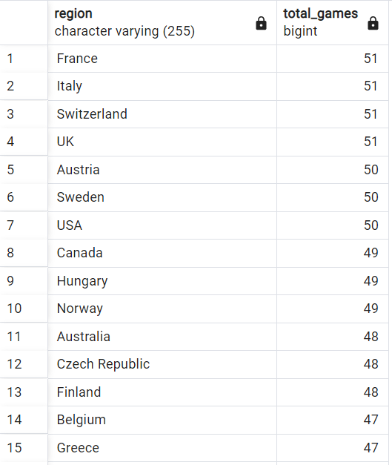
Q5:Write SQL query to return the list of countries who have been part of every Olympics games.
with gamescounts as (
select n.region,count(distinct e.games) as total_games
from athlete_events e
join noc_regions n on n.noc=e.noc
group by n.region
order by total_games desc
)
select gamescounts.region,gamescounts.total_games
from gamescounts
group by region,total_games
order by total_games desc;

Slide 9
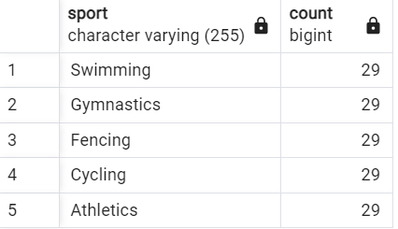
Q6: Write SQL query to fetch the list of all sports which have been part of every olympics.
select distinct sport,count(sport)
from(
select distinct games,sport
from athlete_events
where season='Summer’
) as t1
group by sport
having count(sport)=( select count(distinct games)
from athlete_events
where season='Summer’)
order by sport desc;

Slide 10
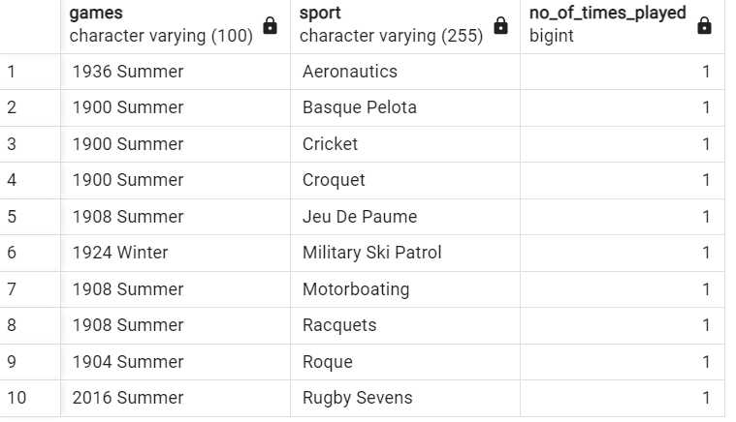
Q7. Which Sports were just played only once in the olympics.
with t1 as(
select distinct games,sport
from athlete_events
order by games
),
t2 as(
select sport,count(sport) as No_of_times_played
from t1
group by sport
having count(sport)=1
order by sport
)
select t1.games,t2.*
from t2
join t1 on t1.sport=t2.sport
order by sport;

Slide 11
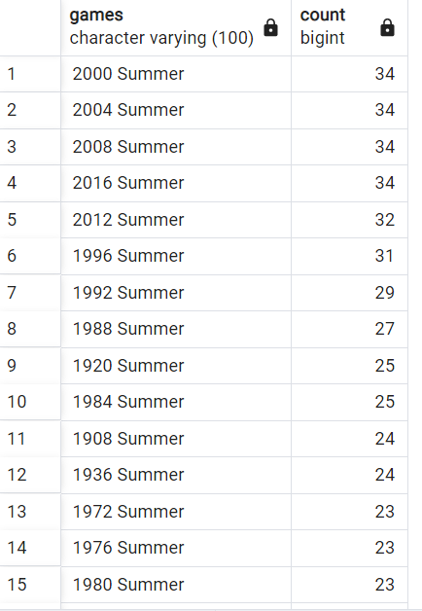
Q8: Fetch the total no of sports played in each olympic games.
select distinct games,count(*)
from(
select games,sport
from athlete_events
group by games,sport
order by games
) as t1
group by games
order by count(*) desc;

Slide 12
Q9: Fetch oldest athletes to win a gold medal
with oldest as(
select name, sex, noc, age::int, team, games, season, city, sport, event, medal
from athlete_events
where age !='NA' and medal='Gold’
),
ranks as(
select *,rank() over(order by oldest.age desc) as age_rank
from oldest
)
select name ,sex ,noc as country, age, team, games, season, city, sport, event, medal from ranks where age_rank=1;

Slide 13

Q10: Find the Ratio of male and female athletes participated in all olympic games
with male as(
select count(*) as male
from athlete_events
where sex='M'
),
female as(
select count(*) as female
from athlete_events
where sex='F'
)
select concat('1: ',round((male/female::decimal),2)) as ratio
from male,female;

Slide 14
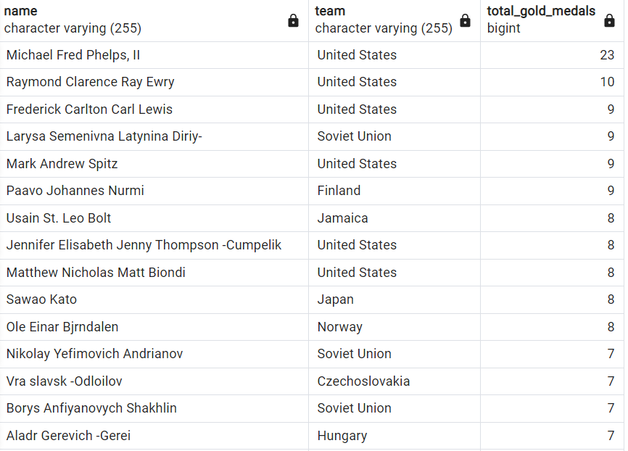
Q11: Fetch the top 5 athletes who have won the most gold medals.
with t1 as(
select name,team,count(*) as total_gold_medals
from athlete_events
where medal='Gold'
group by name,team
order by total_gold_medals desc
),
t2 as(
select *,dense_rank() over(order by total_gold_medals desc) as rnk
from t1
)
select name,team,total_gold_medals from t2
where rnk<=5;

Slide 15
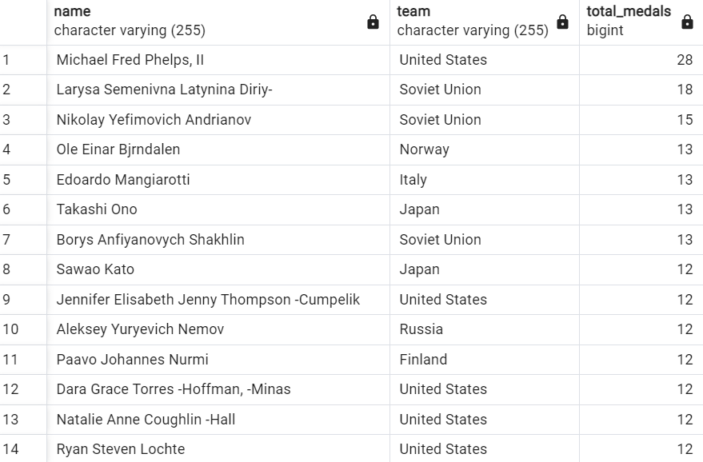
Q12: Fetch the top 5 athletes who have won the most medals (gold/silver/bronze).
with t1 as(
select name,team,count(*) as total_medals
from athlete_events
where medal in ('Gold','Silver','Bronze')
group by name,team
order by total_medals desc
),
t2 as(
select *,dense_rank() over(order by total_medals desc) as rnk
from t1
)
select name,team,total_medals
from t2
where rnk<=5;

Slide 16
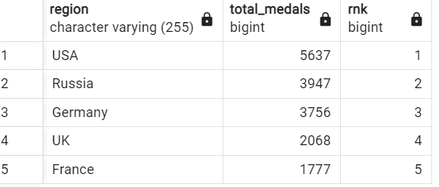
Q13: Fetch the top 5 most successful countries in olympics. Success is defined by no of medals won.
with t1 as(
select n.region, count(*) as total_medals
from athlete_events e
join noc_regions n on n.noc=e.noc
where medal!='NA'
group by region
order by total_medals desc
),
t2 as(
select *, dense_rank() over(order by total_medals desc) as rnk
from t1
)
select * from t2
where rnk<=5;

Slide 17
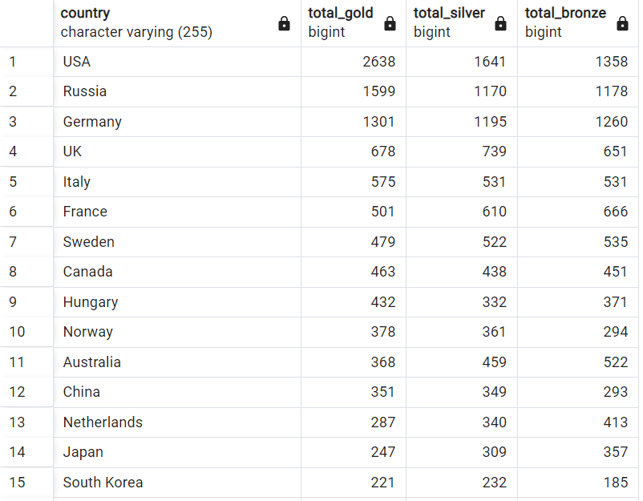
Q14: List down total gold, silver and bronze medals won by each country.
select n.region as Country,
sum(case when medal='Gold' then 1 else 0 end) as Total_Gold,
sum(case when medal='Silver' then 1 else 0 end) as Total_Silver,
sum(case when medal='Bronze' then 1 else 0 end) as Total_Bronze
from athlete_events e
join noc_regions n on n.noc=e.noc
group by n.region
order by Total_Gold desc,Total_Silver desc,Total_Bronze desc, n.region;

Slide 18
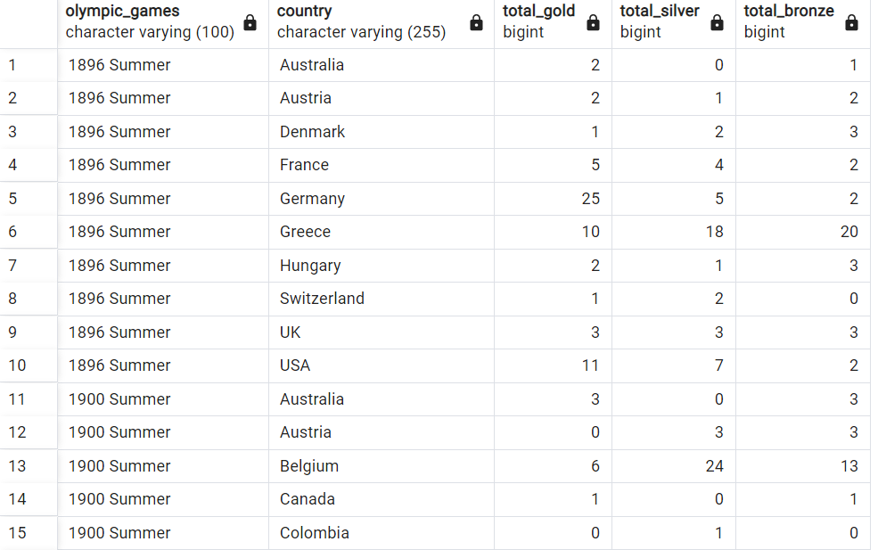
Q15. List down total gold, silver and bronze medals won by each country corresponding to each olympic games.
select e.games as Olympic_games,n.region as Country,
sum(case when medal='Gold' then 1 else 0 end) as Total_Gold,
sum(case when medal='Silver' then 1 else 0 end) as Total_Silver,
sum(case when medal='Bronze' then 1 else 0 end) as Total_Bronze
from athlete_events e
join noc_regions n on n.noc=e.noc
where e.medal in ('Gold','Silver','Bronze’)
group by e.games,n.region
order by e.games,n.region;

Slide 19
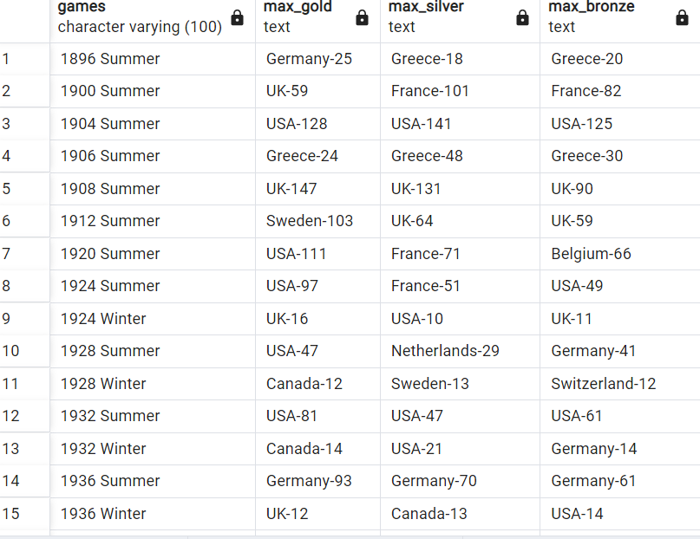
Q16: Identify which country won the most gold, most silver and most bronze medals in each olympic games.
with medalcount as(
select e.games,n.region as Country,
sum(case when medal='Gold'then 1 else 0 end) as GoldCount,
sum(case when medal='Silver' then 1 else 0 end) as SilverCount,
sum(case when medal='Bronze'then 1 else 0 end) as BronzeCount,
row_number() over(partition by e.games order by sum(case when
medal='Gold'then 1 else 0 end)desc) as GoldRank,
row_number() over(partition by e.games order by sum(case when
medal='Silver' then 1 else 0 end)desc) as SilverRank,
row_number() over(partition by e.games order by sum(case when medal='Bronze’
then 1 else 0 end)desc) as BronzeRank
from athlete_events e
join noc_regions n on n.noc=e.noc
where e.medal in ('Gold','Silver','Bronze')
group by e.games,Country
)
select games,
max(case when GoldRank=1 then concat(Country,'-',GoldCount) end) as Max_Gold,
max(case when SilverRank=1 then concat(Country,'-',SilverCount) end) as Max_Silver,
max(case when BronzeRank=1 then concat(Country,'-',BronzeCount)end) as Max_Bronze
from medalcount
group by games
order by games;

Slide 20
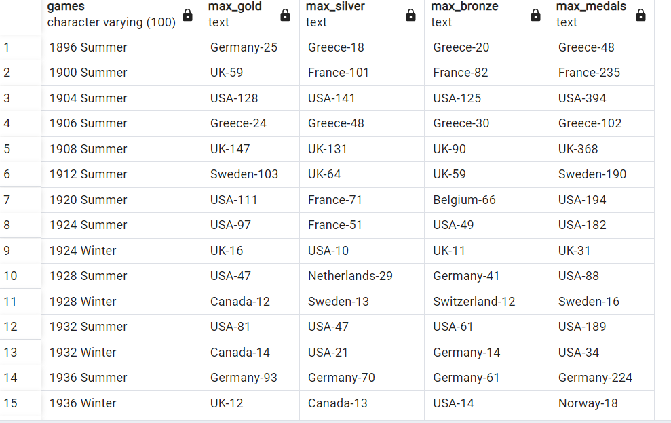
Q17: Identify which country won the most gold, most silver, most bronze medals and the most medals in each olympic games.
with medalcount as(
select e.games,n.region as Country,
sum(case when medal='Gold'then 1 else 0 end) as GoldCount,
sum(case when medal='Silver' then 1 else 0 end) as SilverCount,
sum(case when medal='Bronze'then 1 else 0 end) as BronzeCount,
sum(case when medal in ('Gold','Silver','Bronze') then 1 else 0 end)as TotalCount,
row_number() over(partition by e.games order by sum(case when medal='Gold'then 1 else 0 end)desc) as GoldRank,
row_number() over(partition by e.games order by sum(case when medal='Silver' then 1 else 0 end)desc) as SilverRank,
row_number() over(partition by e.games order by sum(case when medal='Bronze' then 1 else 0 end)desc) as BronzeRank,
row_number() over(partition by e.games order by sum(case when medal in ('Gold','Silver','Bronze')then 1 else 0 end)desc)as TotalRank
from athlete_events e
join noc_regions n on n.noc=e.noc
where e.medal in ('Gold','Silver','Bronze')
group by e.games,Country
)
select games,
max(case when GoldRank=1 then concat(Country,'-',GoldCount) end) as Max_Gold,
max(case when SilverRank=1 then concat(Country,'-',SilverCount) end) as Max_Silver,
max(case when BronzeRank=1 then concat(Country,'-',BronzeCount)end) as Max_Bronze,
max(case when TotalRank=1 then concat(Country,'-',TotalCount)end) as Max_Medals
from medalcount
group by games
order by games;

Slide 21
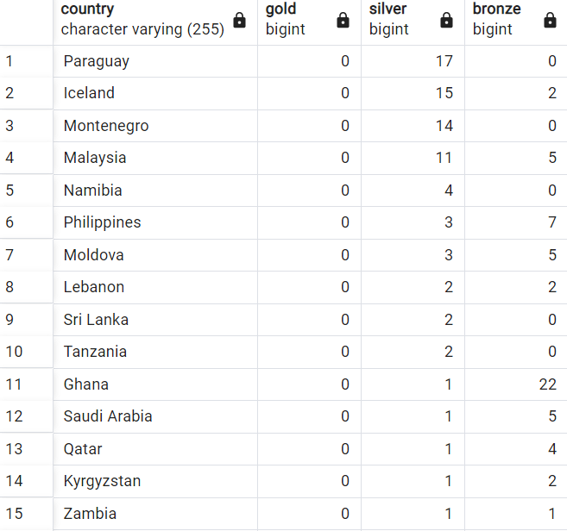
Q18: Which countries have never won gold medal but have won silver/bronze medals?
select n.region as Country,
sum(case when e.medal='Gold' then 1 else 0 end) as Gold,
sum(case when e.medal='Silver' then 1 else 0 end) as Silver,
sum(case when e.medal='Bronze' then 1 else 0 end) as Bronze
from athlete_events e
join noc_regions n on n.noc=e.noc
group by n.region
having sum(case when e.medal='Gold' then 1 else 0 end)=0 and
(sum(case when e.medal='Silver' then 1 else 0 end) > 0 or sum(case when e.medal='Bronze' then 1 else 0 end)>0)
order by Gold desc,Silver desc,Bronze desc;

Slide 22
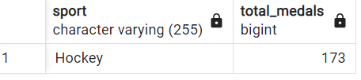
Q19: In which Sport/event, India has won highest medals.
select sport,count(medal) as Total_medals
from athlete_events e
join noc_regions n on n.noc=e.noc
where n.region='India' and medal in ('Gold','Silver','Bronze’)
group by sport
order by Total_medals desc
limit 1;

Slide 23
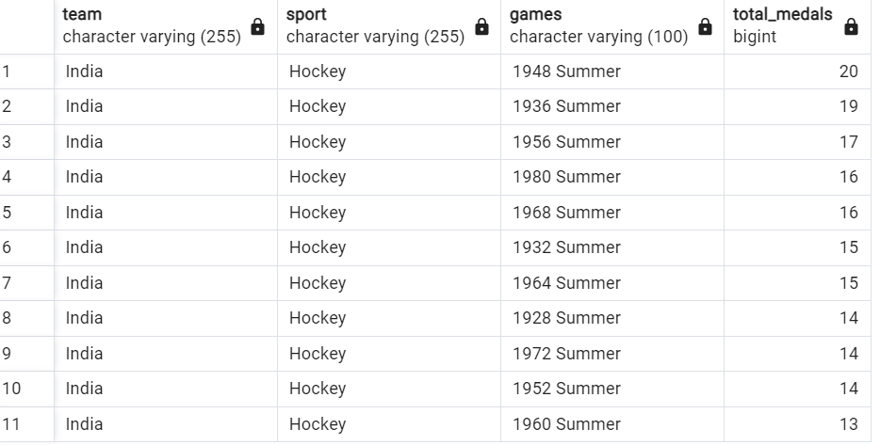
Q20: Break down all olympic games where India won medal for Hockey and how many medals in each olympic games
select team,sport,games,count(medal) as Total_Medals
from athlete_events
where team='India' and sport='Hockey' and medal in('Gold','Silver','Bronze’)
group by team,sport,games
order by Total_Medals desc;

